Slide 1
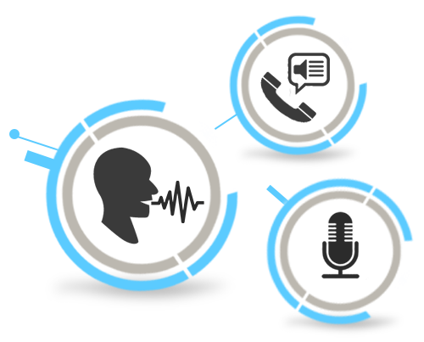
INTELLIGENT LOCAL VOICE ASSISTANT USING ML
Presented By:
Dibya Ranjan Rath(20BCSE62)
Anubhav Mohanty(20BCSB26)
Guided By: DR Satyananda Champati Rai

Slide 2
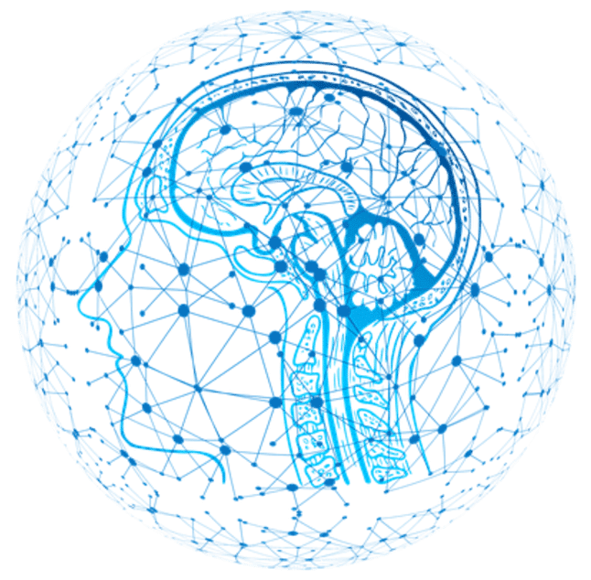
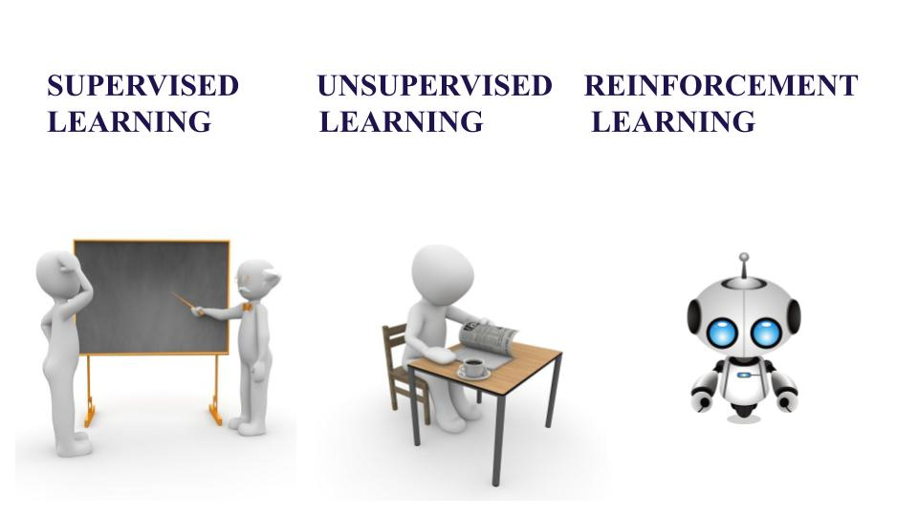
INTRODUCTION
What is Machine Learning?
Machine Learning is the process which allows machine to learn from past data or historical data or algorithm to improve performance by doing certain task.
Types of Machine Learning:
Supervised Learning:
In supervised learning we teach / trained the machine using labelled data and the aim is to predict dataset.
Algorithm like Linear Regression, Logistic Regression, KNN, Decision tree, Random forest are used supervised learning.

Slide 3
Unsupervised Learning:
In unsupervised learning the machine is trained on unlabeled data and the aim is to discover unknown patterns and discover output.
Algorithm like K-Means is used unsupervised learning.
Reinforcement Learning:
In reinforcement learning an agent interacts with its environment by producing error or rewards and the aim is to learn series of actions.
Algorithm like Q-learning is used reinforcement learning.

Slide 4
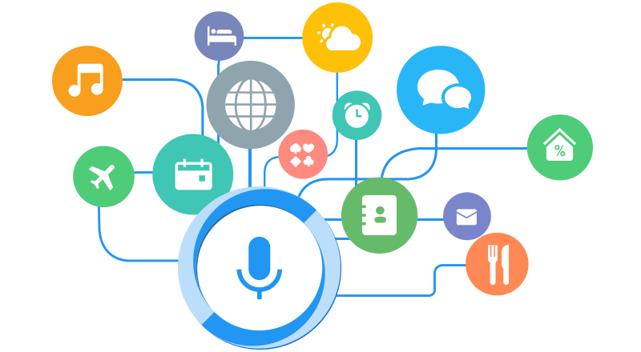
PROJECT
LEO
Your Personal Local
Voice Assistant

Slide 5

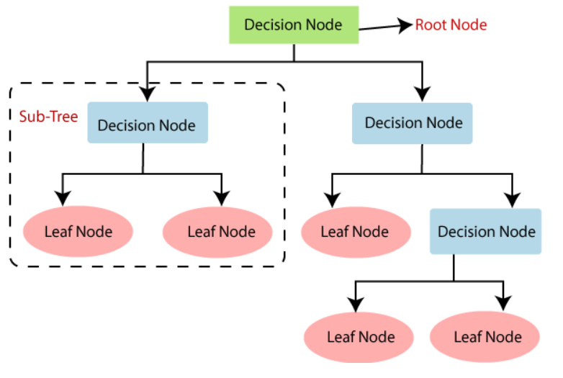
Algorithm Used: Decision Tree
A decision tree is a supervised learning algorithm used for both classification and regression.
It is a type of model that uses a tree-like structure, where internal nodes represent the features of a dataset, branches represent the decision rules and each leaf node represents the outcome.
In a Decision tree, there are two nodes, which are-
Decision Node (used to make any decision)
Leaf Node (these are the output of those decisions )
The goal is to create a model that predicts the value of a target variable by learning simple decision rules inferred from the data features.

Slide 6
STEPS TO IMPLEMENT
Data Pre-processing
Create Dataset
Arrange Data into features and target
Implementation of Algorithm
Import necessary packages (like: speech_recognition, pyttsx3, sklearn.tree, DecisionTreeClassifier, pandas, webbrowser and urllib.parse).
Storing all the inputs value in a variable and response value in another variable
Train the decision tree model
Implement voice recognition system

Slide 7
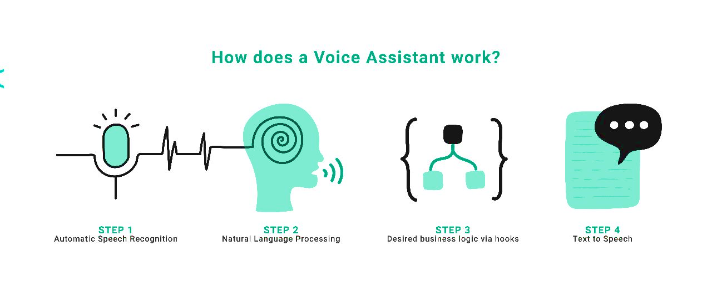
Define a flag to indicate whether the voice assistant should be active or not
If flag is true then voice assistant is active
Use the decision tree model to predict response
Implement text-to-speech system to output response
Print the input and response as text
If flag is false then stop the voice assistant.

Slide 8

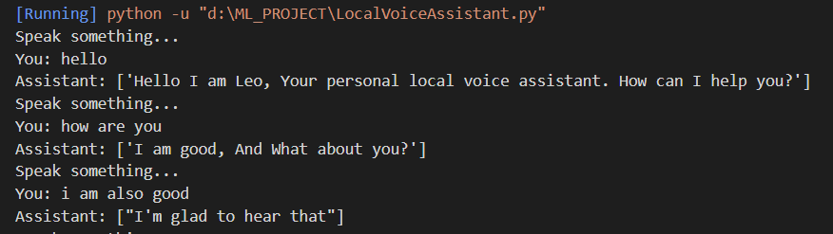
SAMPLE OUTPUT

Slide 9

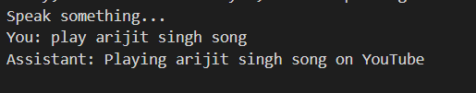
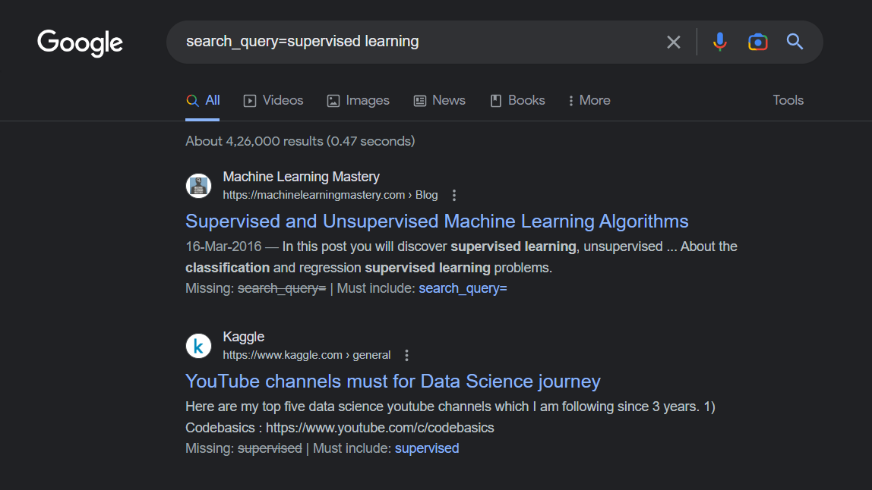

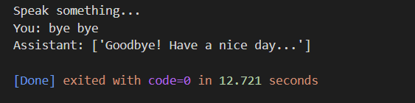

Slide 10
CONCLUSION
In our project we utilized decision tree algorithms, which gives higher accuracy than other machine learning algorithms.
The use of decision tree algorithms in local voice assistants has shown great potential in recognizing speech commands and responding accordingly.
These systems can be particularly useful in situations where internet connectivity is limited or unavailable, making it challenging to use cloud-based voice assistants.

Slide 11
REFFERENCE
“Investigation and Development of the Intelligent Voice Assistant for the Internet of Things Using Machine Learning” by Polyakov E. V., Mazhanov M. S. , Rolich A. Y. , Voskov L. S. Kachalova M. V., Polyakov S. V. In 2018 Moscow Workshop on Electronic and Networking Technologies (MWENT)

Slide 12

THANK YOU🙏

